Slide 1


Slide 2

Developing Capacity Building Actions to support Innovative HE Reforms – How?
Notes:
How Uppsala University develops capacity building actions to support innovative HE reforms

Slide 3
Erasmus Mundus Action 2 Grantees at Uppsala University 2009 - 2018
Top 10
China | 85
India | 63
South Africa | 46
Brazil | 36
Thailand | 29
Vietnam | 27
Palestine | 22
Syria | 16
Pakistan | 16
Jordan | 16
1-3
4-9
10-15
31+
16-20
21-30
Number of grantees
Total 530 grantees from 56 countries
Notes:
Many of the international projects today that are focused on capacity building stems/derives from the experiences of the old EU-funded action Erasmus Mundus Action 2 (29 projects, 3 as coordinators)
2009-2018
530 grantees from 56 countries outside Europe
Students on all levels including PhD students, post-docs, academic and administrative staff
The biggest amount from ASIA
Asian grantees: 367 (includ 59 from Middle East)
Latin America: 80 grantees
African: 79 grantees
What we learnt from EMA2 we brought in to the new EU-funded programme that was launched in 2014. It is called Erasmus+ and has different key actions,
namely Erasmus+ Capacity building and Erasmus+ ICM

Slide 4

Erasmus+ Capacity Building in HE (CBHE)
2014-2018: UU participates in 11 Erasmus+ CBHE projects
(4 as coordinators)
UU one of the more active universities in Europe
New trend: Non-EU universities = coordinators
UU International Office writes and coordinates all new CBHE applications
Researchers and other units participate as experts in the different projects
Notes:
All CBHE projects are coordinated from the International Office – all administration including reporting!!!
IO has built its own capacity to run and administrate these kind of projects. The teachers can be teachers and do not have to focus on (or drown in paper work) the practical aspects of managing a project.
New CBHE applications 2019 (UU partner):
Developing Inclusive Education for Students with Disabilities in Sri Lankan universities (DIESD)
– University of Peradeniya
Strengthening Higher Education Technology And Innovation Commercialization
– Malawi University of Science and Technology (MUST)
Open Innovation in Higher Education - Network for Solving Micro & SMEs’ Problems
– National University of Salta, Argentina
NOHA Latin America
– NOHA network (Brussels)

Slide 5
Uppsala University is partner in Erasmus+ CBHE projects:
Nizami (Azerbaijan) - Reforming doctoral education in Azerbaijan
Yebo (South Africa) - Development of the internationalization of PhD studies in ZA
Integrity (Georgia) - Academic integrity for quality teaching and learning in HEIs in Georgia (Plagarisim)
Gecko (Indonesia, Thailand, Philippines) – Improving employability of engineering studies
Chinlone (Myanmar) - Modernising and internationalising of the Myanmar HEI
Toolkit (Myanmar, Laos, Sri Lanka)- Strengthening internationalization strategies and creating tools for Myanmar, Lao and Sri Lankan HEI
Sica (Cambodia) - Strengthening quality assurance in Cambodian higher education
Notes:
4 out of 7 focus on South East Asia.
Enter into a new CBHE project:
Consider good partners from ”old” projects;
Co-operated with the coordinator before? (Do we know their administrative capacity?
Look at the other partner institution – ”Old friends”?
Synergies with other ongoing projects / previous projects
Is the region of strategic importance, which previous projects / initiatives are in the region]
Is the coordinator / partner with one of the university's networks
(mainly Coimbra, Matariki, U4, SANORD, Nordic Center Fudan, Baltic University Program)
or existing exchange activities or links to centers at UU such as ISP, Forum for Africa studies

Slide 6

Uppsala University is the coordinator of the Erasmus+ CBHE projects:
Emisha (South Africa) - Entrepreneurship, modernization and innovation
LISTO (Argentina, Brazil, Uruguay) – Innovation & entrepreneurship
EASTEM (Vietnam, Thailand, Indonesia) – Learning & teaching STEM to increase employability after graduation
EVENT (Vietnam) – Employability of graduates
Notes:
IMPORTANT TO INVOLVE MINISTRIES so that the these projects impact/reform HEI in a sustainable way.
EVENT: 2 Vietnamese universities in Hanoi, 1 in Hue and 2 in Ho Chi Minh City
EASTEM:
10 universities in Asian and 3 in Europe
3 Thai
3 Vietnamese
4 Indonesian

Slide 7
Common features between EVENT and EASTEM:
Aims:
To contribute to an increased employability of university graduates
Bridge the gap between industry and universities by ensuring that students acquire hard skills as well as soft skills needed in the workplace
Activities:
Train lecturers in student-centered competence development
Modify the curricula to increase relevance of education for the labour market
Establish Career Centers (STEM centers) at partner universities to serve as local hubs
Notes:
STEM = Science, Technology, Engineering and Mathematics.
In order to increase the employability of students you need to teach them skills
And to teach them the “right” skills you need teachers that are competent and “up-dated”.
Train the trainers.
Soft skill development: Department of IT: (Anders Berglund, Mats Daniels)
Examples of important soft skills are communication, teamwork and problem solving.
Soft skills include:
attitude,
communication skills,
listening skills,
creative thinking,
work ethic,
teamwork,
networking,
decision making,
positivity,
time management,
motivation,
flexibility,
problem-solving,
critical thinking, and
conflict resolution.

Slide 8
Erasmus+ International Credit Mobility (ICM)
Scholarships for incoming and outgoing students, teachers and administrative staff.
So far UU has been approved 44 ICM projects with 450 mobilities
    2015: 5
    2016: 4
    2017: 17
    2018: 18
All Erasmus+ projects are written and coordinated by UU International Office
UU departments participate as experts in the application procedure and as hosts for students and staff
Notes:
Often with one university in one country

Slide 9
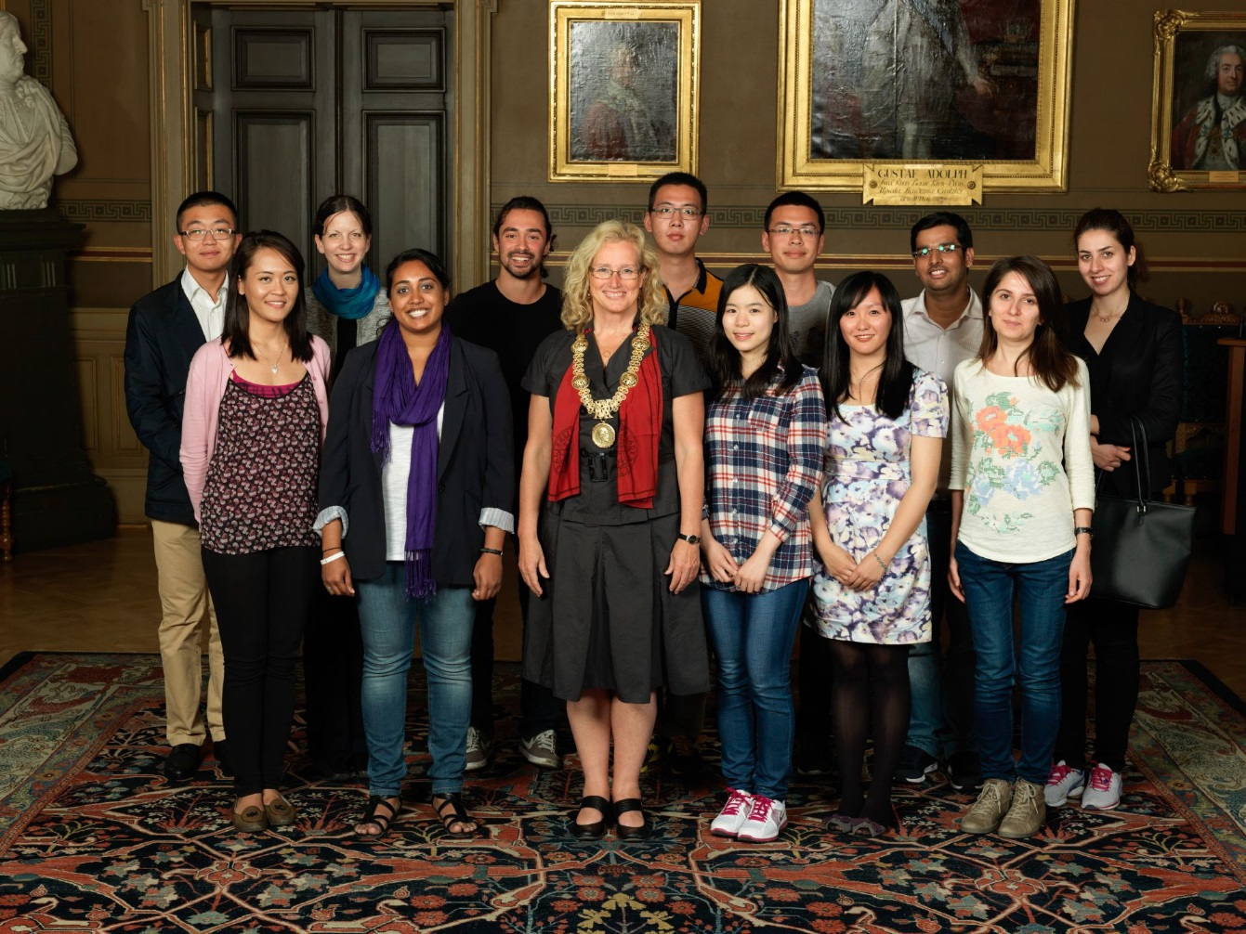
Erasmus+ ICM in South East Asia (and SHARE) 2015-2019
South East Asia so far:
60 grantees to UU
24 grantees from UU
RUB, Bhutan
RUPP, Cambodia
NUoL, Laos
UM, Myanmar
NTNU, Taiwan
HUST, Vietnam
Indonesia
Philippines
Thailand
Notes:
Mostly in all fields, but for some projects eg Bhutan, Vietnam and Taiwan we have focused the application on information technology.
A professor had good Erasmus Mundus students and also met staff from these HEI. This eg lead to a 3+1 programme in Computer Science (3 years at the home institution and 1 year at UU – degree from both institutions).
ICM in total 177 grantees
120 to UU
57 from UU
Free-movers not included

Slide 10
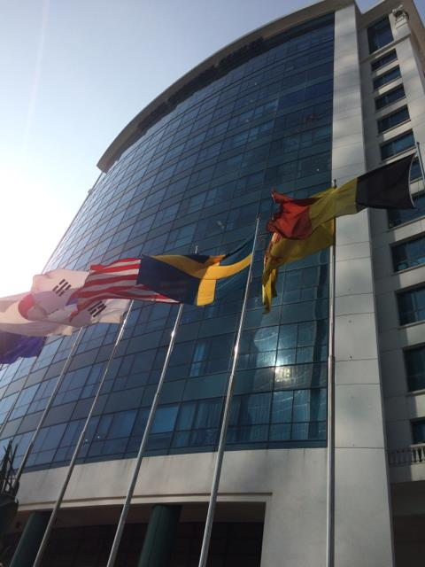
UU Regional Office, Hanoi, Vietnam
Vietnam and neighbouring SEA countries
Main activities:
Exchange in Business, Information Technology, Anthropology and Nursing
Joint program/courses: 3+1 setup in IT, Global Health, Public Management
Support Erasmus+ capacity building projects (EVENT, EASTEM)
Student recruitment in Vietnam and the region
Alumni operation
Notes:
Existence since 2014, now celebrating 5 years
Same building as the the Swedish embassy
One Swedish representative and two local staff
Act as a hub for other Swedish Universities with activities in Vietnam
Today totally 12 different agreements with Vietnamese universities

Slide 11
UU and Myanmar
Erasmus Mundus projects (EMA2) eg Panacea 2012 and LOTUS+ 2014
Erasmus+ ICM with University of Mandalay 2015, 2016 and 2018 (and hopefully 2019!)
SHARE Scholarship Programme
International Science Programme (ISP), www.isp.uu.se
Number of student and staff from Mandalay to UU: 36
Number of staff from UU to Myanmar: 5
Notes:
To wrap up this presentation I just want to show you what can happen if you concentrate your resources to one country or even one institution:
UU and Myanmar
ISP support the establishment of research groups in basic sciences (Physics, Chemistry, Maths) in least developed countries
Just since 2012!
Many of the students that studied at UU now work as teachers at Mandalay.
UU coordinated EMA2 project LOTUS+:
Yezin Agriculture University full partner
University of Mandalay asociate partner
7 student and staff (to EU universities)

Slide 12
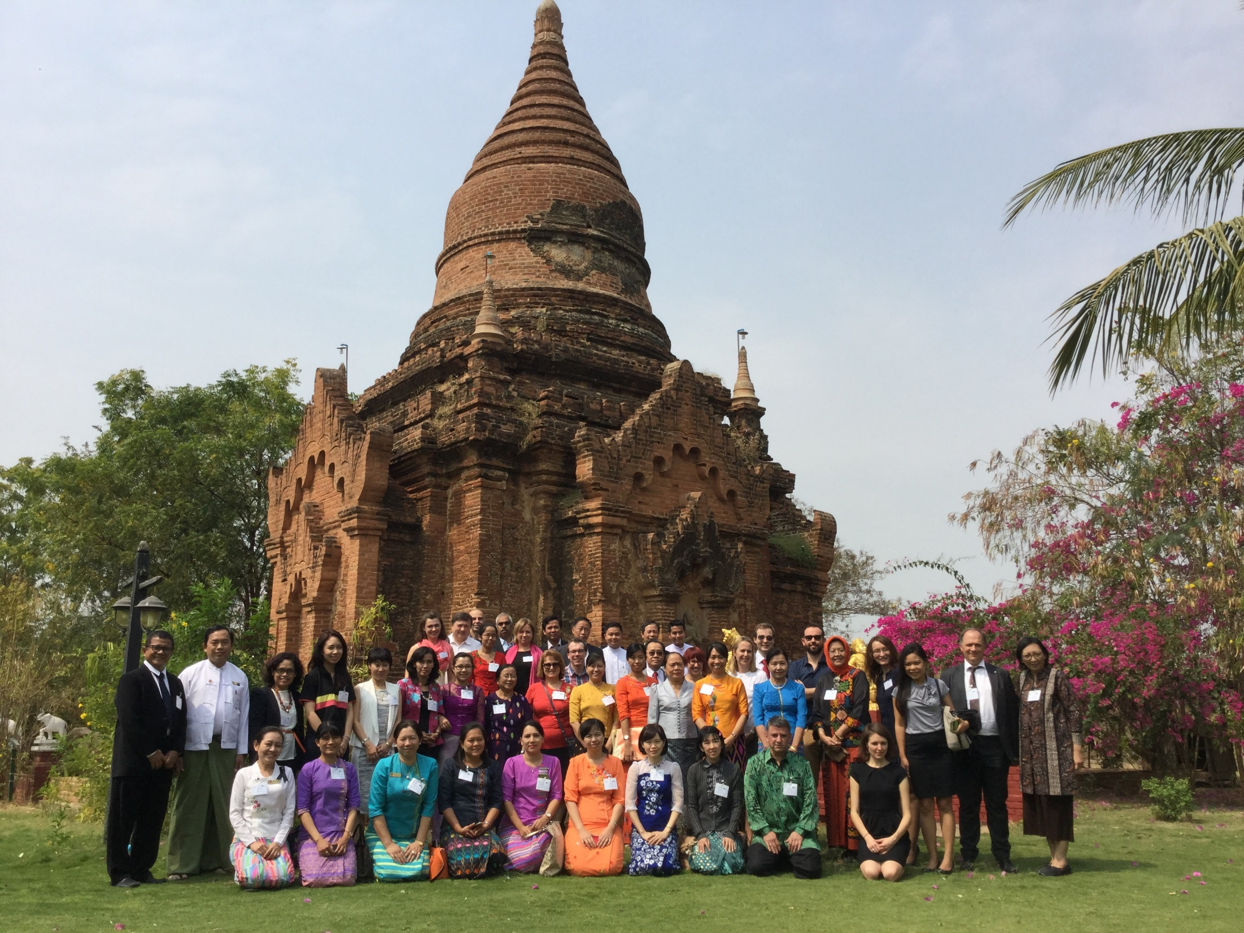
Bagan feb 2016
Notes:
Bagan February 2016 (alumni on the first row)

